Slide 1


Amazon cloth review classification 분석을 통한 평점 예측모델
20191615 소프트웨어학부 신준원

Slide 2
Procedure
1. Preprocessing
2. Comparing stemmizing(porter) to lemmatizing(WordNetLemmatizer)
3. Naïve Bayes, with TF-IDF (1 to 5)
3. Increase score(predict score, laplace and data)
4. Feedback

Slide 3
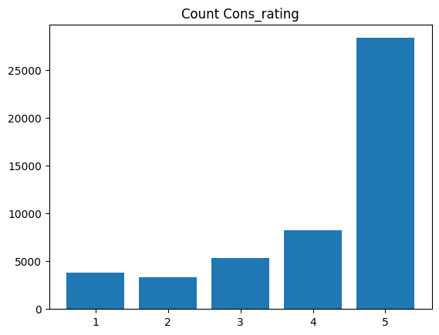
Columns(used)
Title + Review
Cons_rating

Slide 4
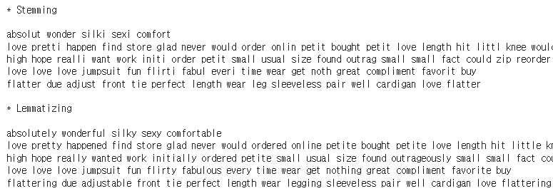
Preprocessing
1. tokenizing (Nltk)
2. Removing stopword (nltk-stopword + number + Name of clothes type)
3. Stemming + Lemmatizing

Slide 5
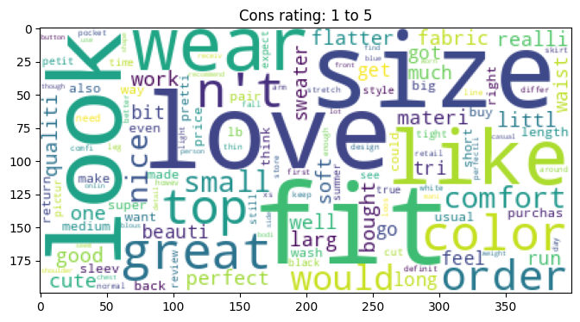
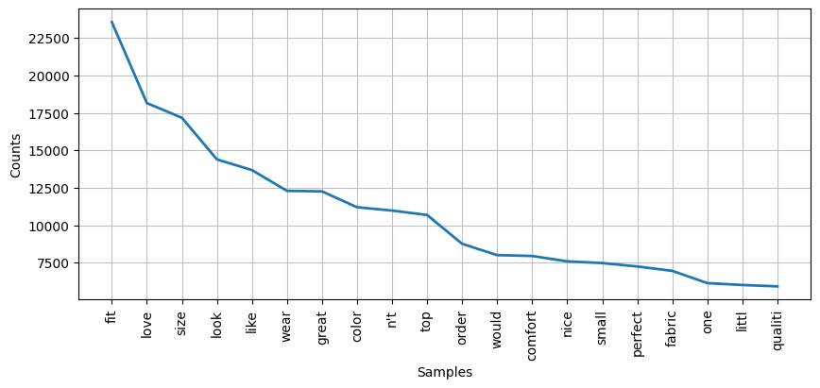
Analyzing Review(1)

Slide 6
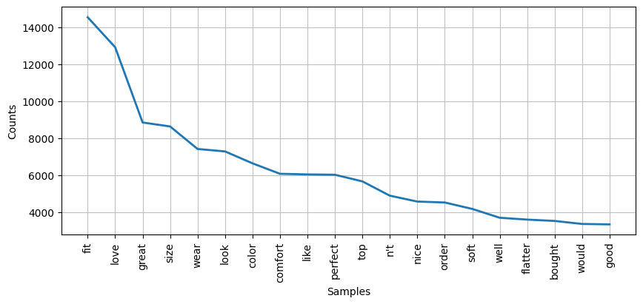
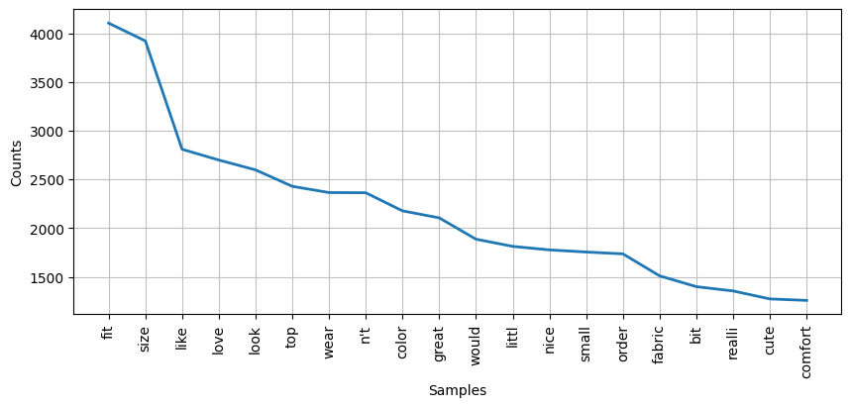
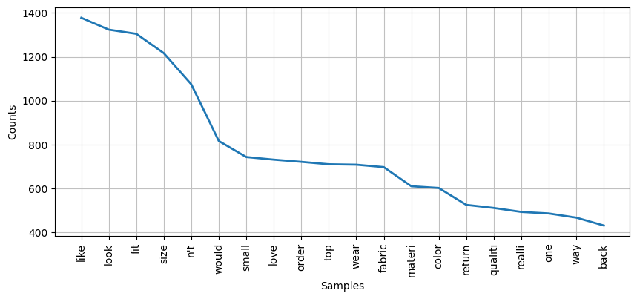
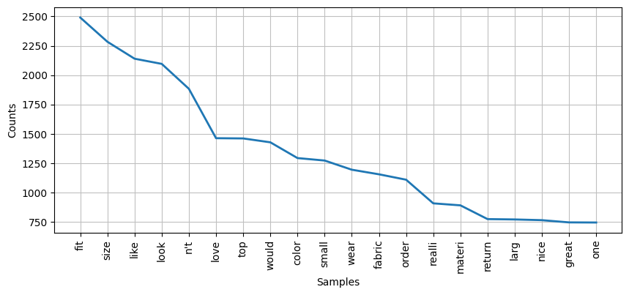
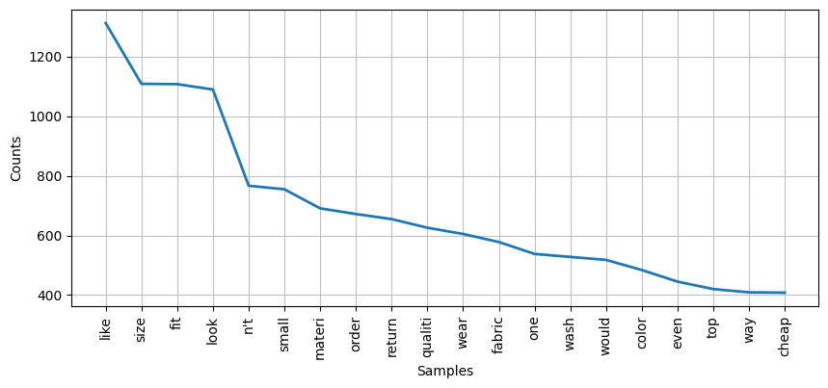
Analyzing Review(2)

Slide 7
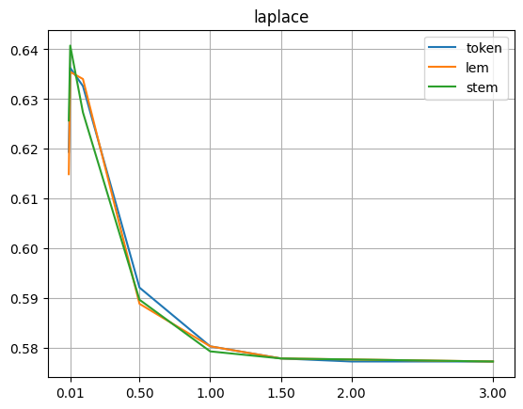
laplace

Slide 8
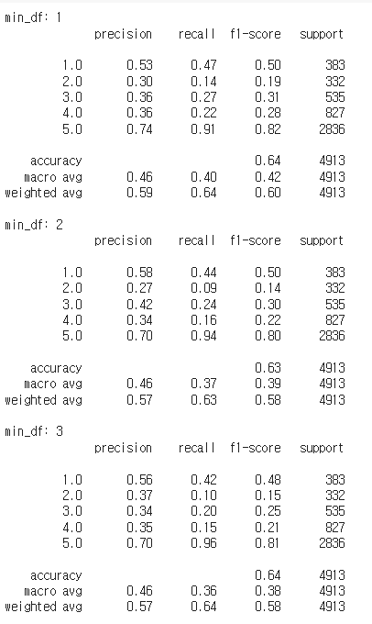
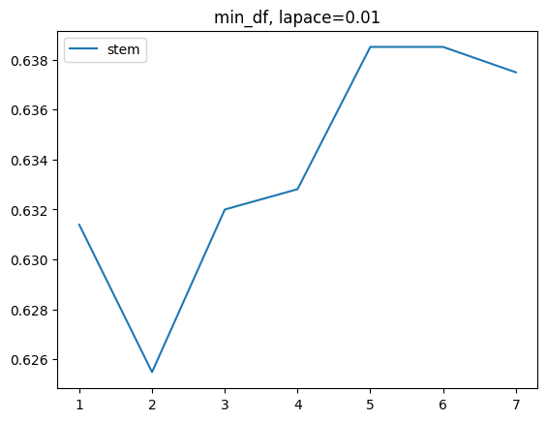
Min_df

Slide 9
Problems
Number of reviews

Slide 10
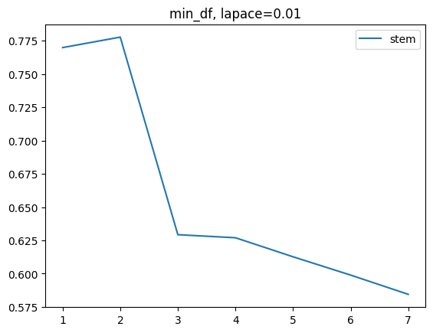
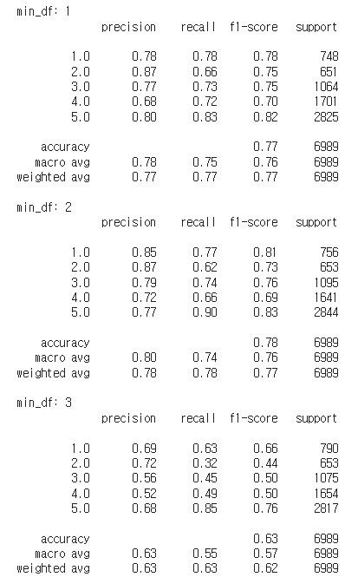
Solution(1. multiply)

Slide 11
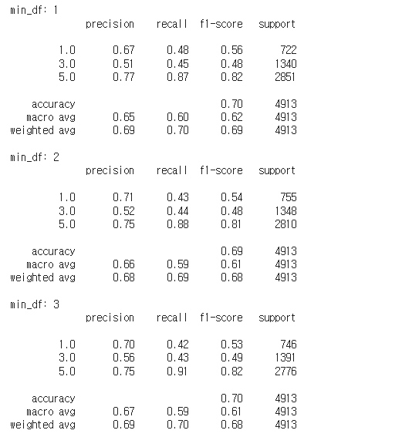
SOLUTION (2. REDUCING CLASS)

Slide 12
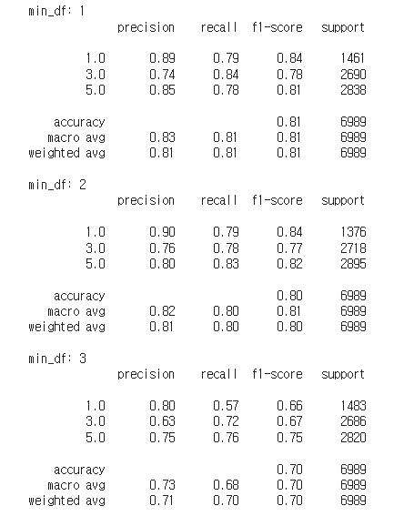
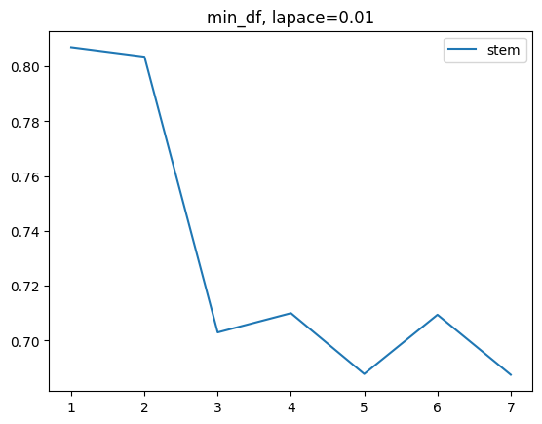
SOLUTION (3. SOL1 + SOL2)

Slide 13
Feedback(how to increase predict value)
Stopword – typo
model

